Slide 1
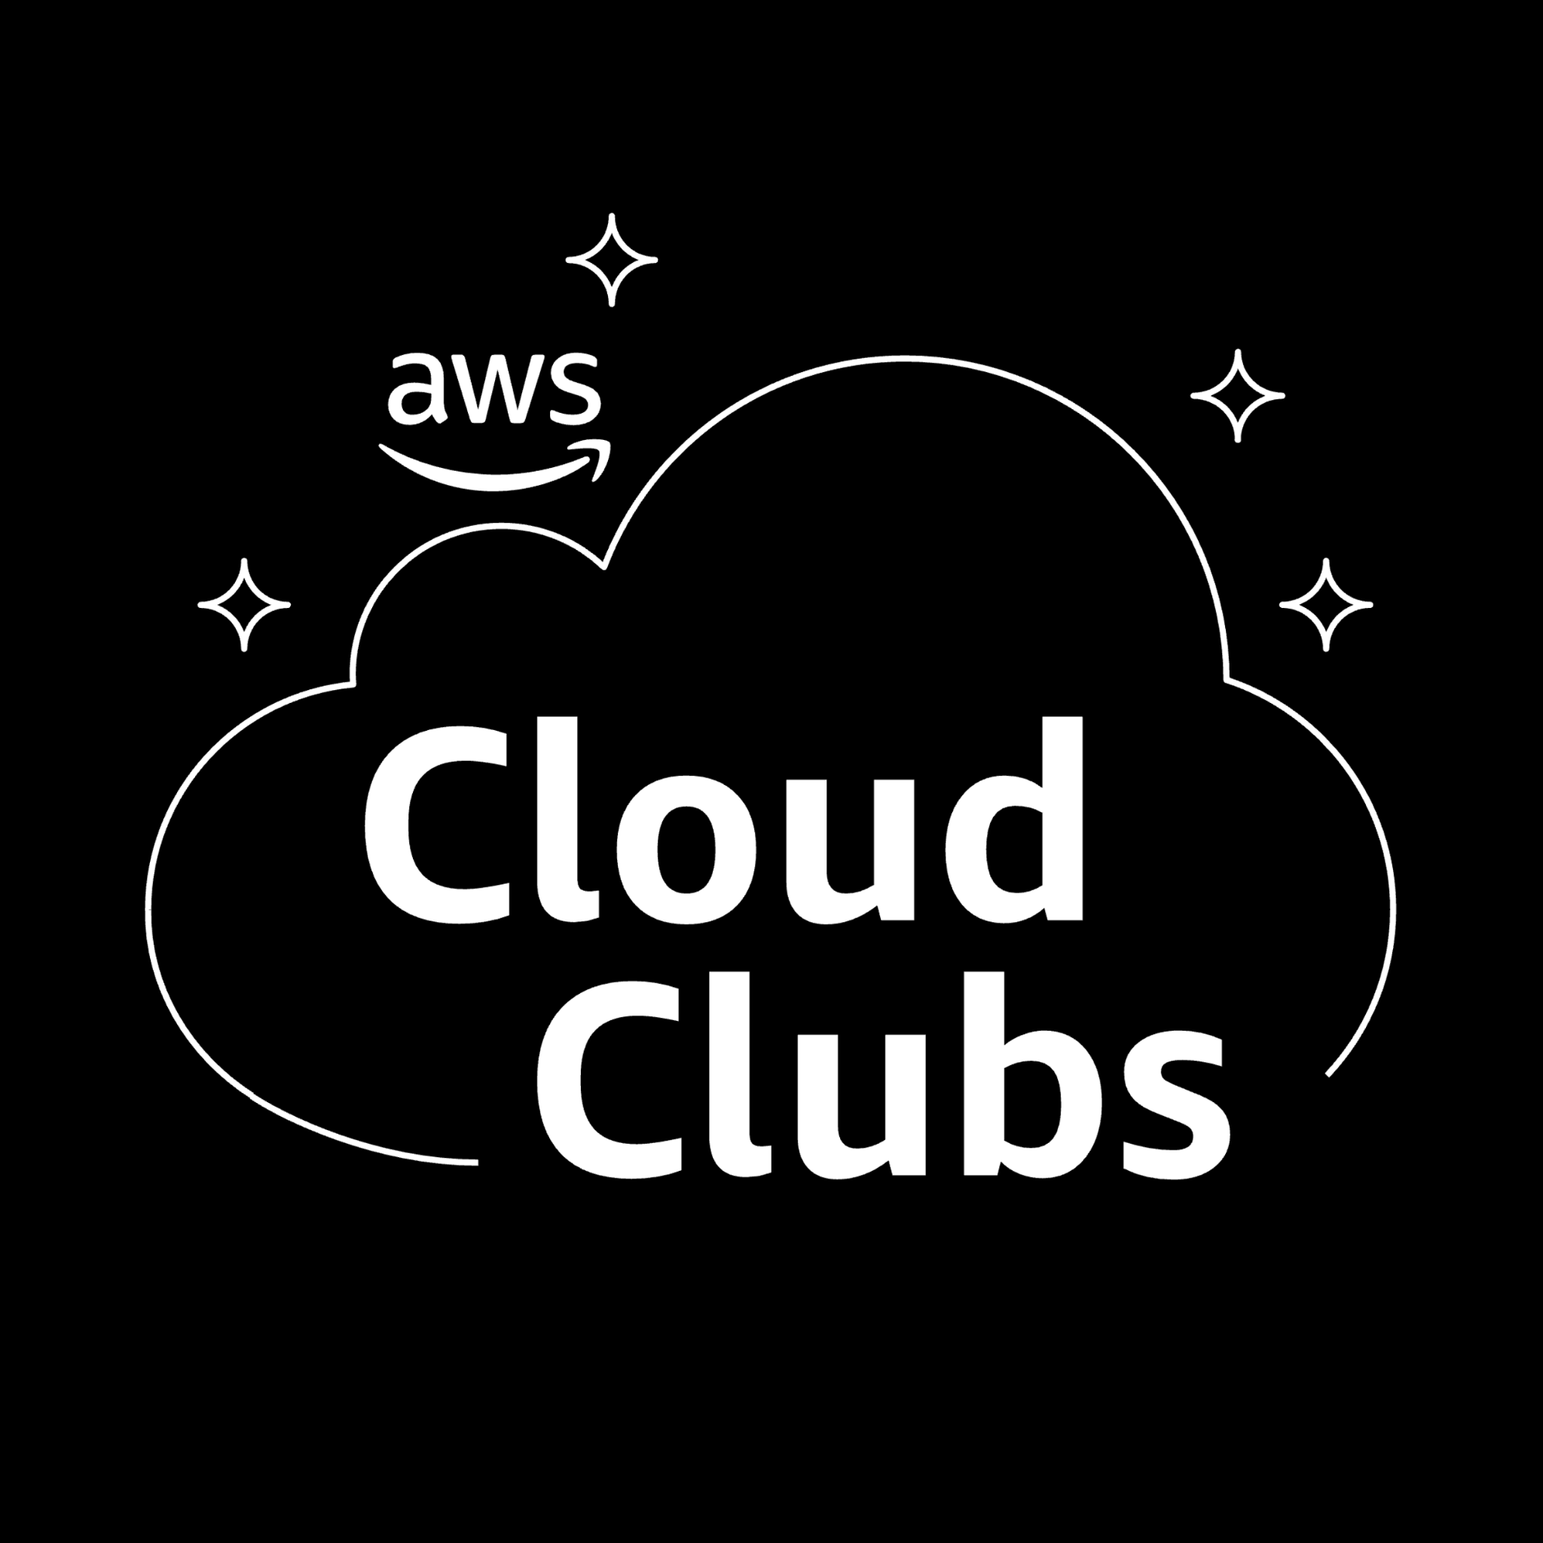

Scan for attendance
Introduction to Containers in AWS
Workshop

Slide 2
Agenda
Containerization
Why?
Docker fundamentals
Docker commands
Container Orchestration
Why?
ECS
Core Concepts
Launch Types
Demo

Slide 3
Cloud Fundamentals
Docker Fundamentals

Slide 4
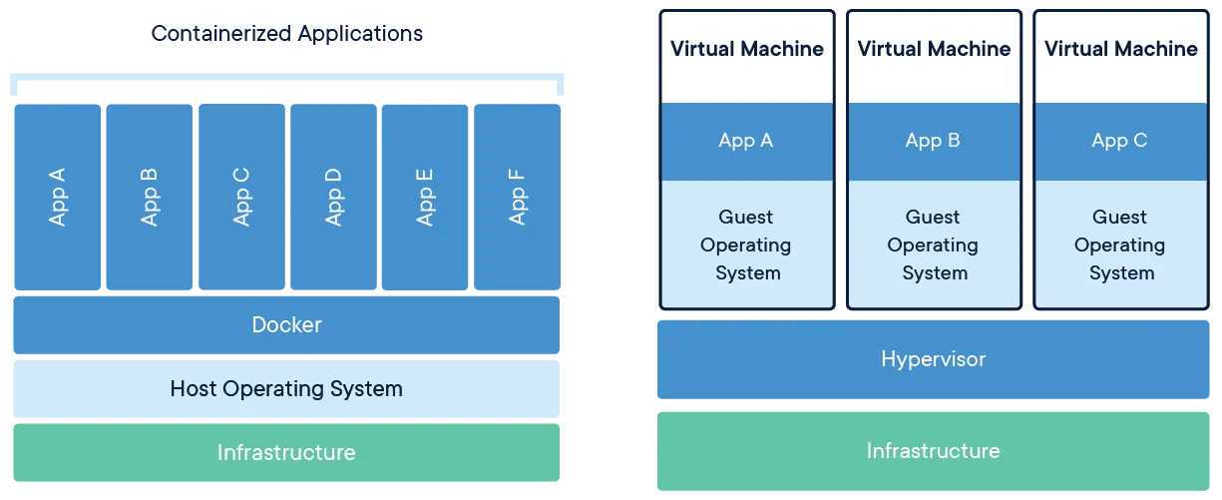
Containerization
Containerization is the standard in modern software development.
Allows an application to run in a single package alongside all of its dependencies, libraries, runtime environment, and other configurations.
Helps solve an age-old software testing problem, “But it works on my machine!”
Notes:
Containers vs vm
VM have operating system which makes it resource-inefficient

Slide 5
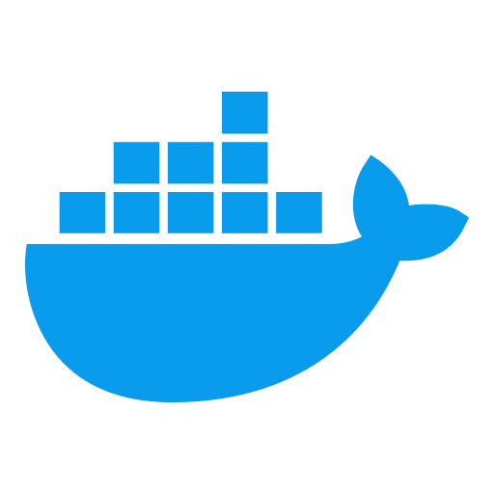
Docker
Docker is the most popular containerization tool.
It allows you to package source code and other files into a Docker image, and then run a container from that image.
A container is a running instance of that image.
Docker images can be uploaded online to Docker Hub or other container registries such as Amazon ECR (Elastic Container Registry).
Notes:
Docker image = recipe for cake, You cant eat cake by this alone The container is the cake made from the recipe

Slide 6
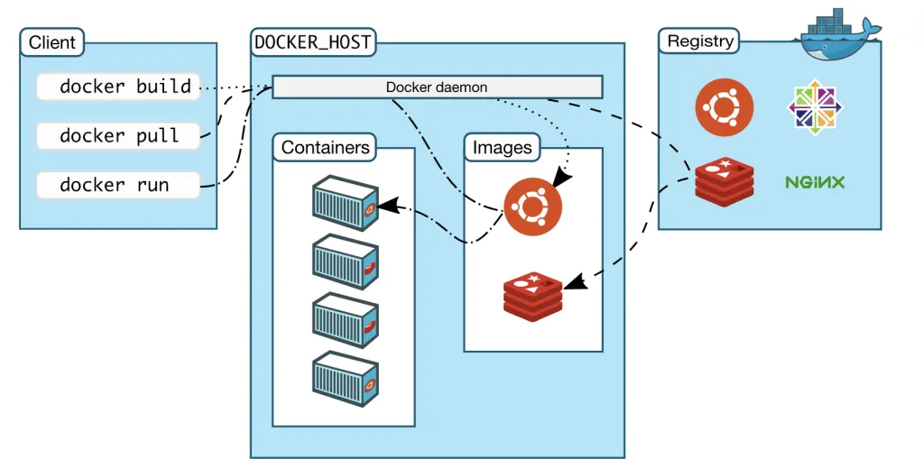
Docker commands
Notes:
Docker pull nginx Docker run -p 3000:80 nginx

Slide 7
Cloud Fundamentals
Container Orchestration
Notes:
This is where container orchestration comes into the picture

Slide 8
Container Orchestration
What if you need to run ten, a hundred, or even a thousand of the same containers?
Container Orchestration allows you to manage and deploy containers at scale.
How?
Docker Swarm
Kubernetes / EKS
Elastic Container Service (ECS)
Notes:
Mainly focusing on Amazon ECS

Slide 9
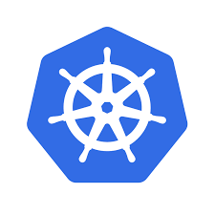
Kubernetes
An open-source platform for automating deployment, scaling, and management of containerized applications.
It is very complex, requires deep expertise to use efficiently, and is often overkill for most applications.
Managed Kubernetes services like EKS are expensive.
Other alternatives may be better suited depending on business needs.

Slide 10
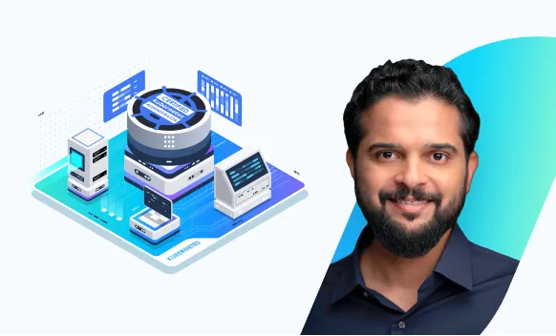
Kubernetes Resources
Very popular for enterprises and it is a sought after skill.
KodeKloud CKA course
Includes practice labs for hands-on experience.
Pair course with Kubernetes Documentation.

Slide 11
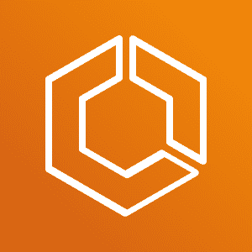
Cloud Fundamentals
Amazon ECS
Notes:
AWS proprietary container orchestration service,
features Easy and Simple to use, unlike kubernetes Can be fully managed by AWS Native integration with AWS ecosystem now lets get started with the core concepts of ECS

Slide 12
ECS Core Concepts
Cluster
Groups of container instances where tasks are run.
ECS supports multiple clusters that can scale independently.
i.e. Prod, Dev, Test environments.
Task definitions
Blueprint of how your task should run.
Contains information about the image(s), CPU, Memory, networking configurations,

Slide 13
ECS Core Concepts
Task
Instantiated from task definitions.
Each task is a running instance of task definitions.
Services
Ensure a specific number of tasks are running.
Integrates with Elastic Load Balancer (ELB) for spreading load across tasks.
Allows auto scaling of tasks based on policies and/or application traffic.

Slide 14
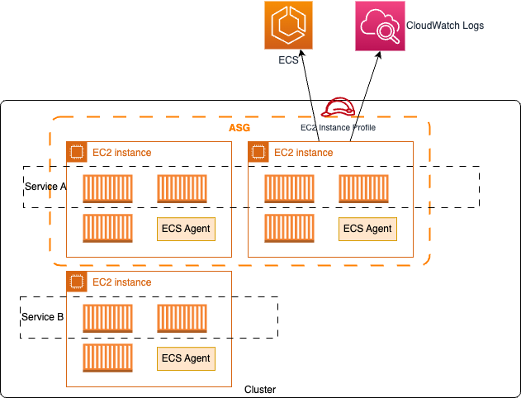

Slide 15
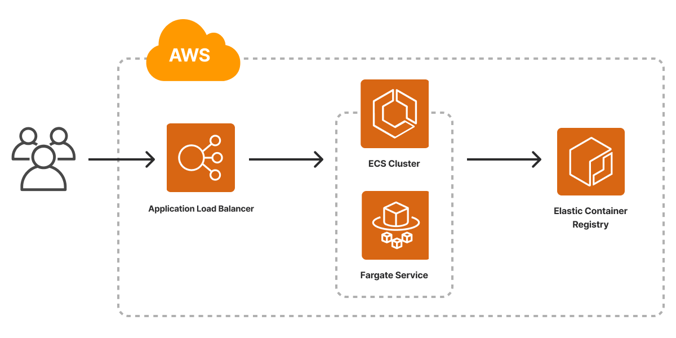

Slide 16
ECS Launch Types
ECS on EC2
With the EC2 launch type, you have full control over the underlying EC2 instances (container instances) that host your tasks
Full control over compute, networking, and IAM.
Ability to use reserved instances or spot instances for cost savings.
Ideal if you need custom AMIs, SSH access to EC2 instances, or Fine-grained control.

Slide 17
ECS Launch Types
ECS Fargate
Serverless compute engine for containers.
Auto-scaling at the task level, Fargate automatically scales resources for individual tasks.
Pay only for the compute resources and storage you use.
Seamless integration with other AWS services.
Ideal when you want to reduce management overhead and need simple scaling.

Slide 18
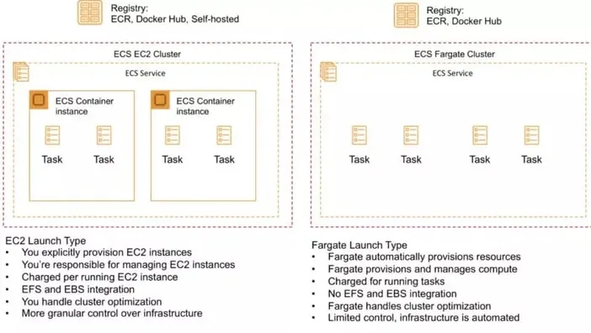

Slide 19
Hands-on Demo
Follow along with text instructions!

Slide 20
AWS Containers Workshop

